Slide 1
FUNDAMENTALS - I
Lecture-2
Programming Fundamentals in C++
Prateek Narang

Slide 2
Brain Teasers?

Slide 3

Warm up!
Write a pseudo code to print the following pattern
1
01
101
0101
10101

Slide 4
BT – 4: Criminal Cupbearers
An evil king has 1000 bottles of wine. A neighboring queen plots to kill the bad king, and sends a servant to poison the wine. The king's guards catch the servant after he has only poisoned one bottle. The guards don't know which bottle was poisoned, but they do know that the poison is so potent that even if it was diluted 1,000,000 times, it would still be fatal. Furthermore, the effects of the poison take one month to surface. The king decides he will get some of his prisoners in his vast dungeons to drink the wine. Rather than using 1000 prisoners each assigned to a particular bottle, this king knows that he needs to murder no more than 10 prisoners to figure out what bottle is poisoned, and will still be able to drink the rest of the wine in 5 weeks time. How does he pull this off?

Slide 5
Binary Number System!

Slide 6
How is data stored?
Whole Numbers / Positive Integers – Binary Equivalent. E.g: 23 → 10111
Characters – Binary Equivalent of their ASCII Values. E.g: ‘A’ → 65 → 1000001
Negative Numbers – 2’s complement of their counter part
Floating Values – Binary Equivalent of 2 integers [ Significant and Exponent]. E.g: 1.23 can be respresented as 123 * 10^-2. So we now have two integers 123 and -2.

Slide 7
Time to write our first program!

Slide 8
Program to print “Hello World”
#include <iostream>
using namespace std;
int main() {
cout << “Hello world!”;
return 0;
}

Slide 9
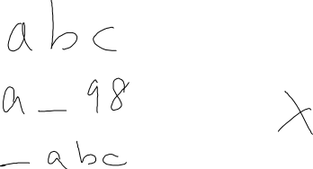


Identifiers
A C++ identifier is a name used to identify a variable, function, class, module, or any other user-defined item
An identifier starts with a letter A to Z or a to z or an underscore (_) followed by zero or more letters, underscores, and digits (0 to 9)

Slide 10
Keywords
Some reserve words which cannot be used as identifiers
These are basically part of the grammar representing the language
E.g: if, while, return, namespace, etc.

Slide 11
Data types
As we know we need variables to store information.
We might want to store information of various types in a variable like character, whole numbers, integers, floating point, boolean etc.
Based on the data type of a variable, the operating system allocates memory and interprets the combination of 0s and 1s in that memory

Slide 12
Primitive Data Types
Boolean - bool
Character - char
Integer – int
Floating Point – float
Double Floating Point – double
Notes:
Talk about size and representation
Float – significand has 24 bits
Double – significand has 53 bits

Slide 13

Data type modifiers
Several of the basic types can be modified using one or more of these type modifiers
signed
unsigned
short
long

Slide 14
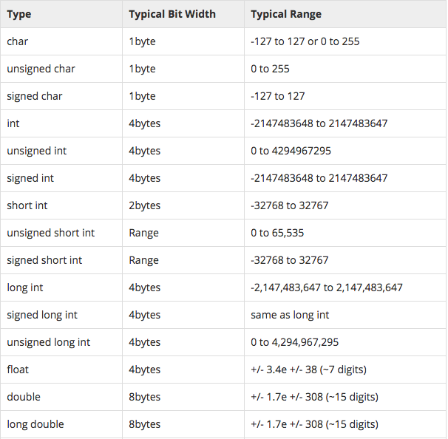
Data types – size and range!

Slide 15
Variables
C++ is strongly typed language, so every variable must be defined before using it.
type variablelist; // type is the type (eg. int), varName is the name of the variable
e.g:
int sum;
char ch;
float a, b;
Variables when just declared have garbage value until they are assigned a value for the first time
We can assign a specific value from the moment variable is declared, called as initialization of variable.[float b = 0.0;]
Notes:
Talk about common mistakes!
Giving each variable a type when defining in a sequence;
int nValue, int nValue2;
The second error is to try to define variables of different types on the same line, which is not allowed
int nValue1, double dValue2;
The last mistake is the dangerous case. In this case, the programmer mistakenly tries to initialize both variables by using one assignment statement
int nValue1, nValue2 = 5; // wrong (nValue1 is uninitialized!)

Slide 16

Statements & Expressions
A statement in C++ is the smallest independent unit in the language
Statements in C++ are terminated by a semicolon
An expression is a mathematical entity that evaluates to a value
Expressions are often used inside of statements.

Slide 17
Lets look at few statements and expressions!
Notes:
Print – cout
Read – cin
Variable Declaration
Variable Initialization
Assignment
Expression Evaluations and Implicit Conversion

Slide 18
Basic Operators in a Expression
Unary [ +, - ]
Arithmetic [ +, -, /, *, % ]
Brackets [ () ]
Assignment [ = ]
Relational [ ==, !=, >, <, >=, <=]
Logical Operators [ &&, ||, ! ]
PS - 1: Relational Operators and Logical Operators always Evaluate to 0 or 1
PS – 2: For logical evaluation any non-zero value is true.

Slide 19


If Block
Single If
if (a > 10) {
cout << “Hello!”;
}
If Else
If (a>10) {
cout << “Hello!”;
} else {
cout << “World.”;
}
If .. Else If .. Else
If (a>10 && a <20) {
cout << “Hello!”;
} else if (a >20 && a <30) {
cout << “Hello World!”;
} else {
cout << “Welcome to Coding Blocks”;
}

Slide 20


While block
while( condition is true ) {
//do some stuff
}

Slide 21
Lets convert some pseudocodes!
Read P,R,T and calculate SI
Find largest of 3 numbers
Check if a number is prime or not
Write a program to print the following pattern
1
2 3
4 5 6
7 8 9 10

Slide 22
Recap
Program Always starts with main()
{ } are used to enclose a block (function, if, while etc.).
C++ Compiler Ignores whitespace (space, carriage returns, linefeeds, tabs, vertical tabs, etc.)
Output using cout
Input using cin
Header Files
Comments (// & /*… */)

Slide 23
Time to try?
Given a list of N integers, find mean, maximum and minimum value. You would be given first N, and then N integers of the list.
Print all prime numbers between 2 to N
Read N and print the below pattern
1
232
34543
4567654
567898765

Slide 24
Time for Brain Teasers!

Slide 25
BT – 5: Circular Jail Cell
There is a circular jail with 100 cells numbered 1-100. Each cell has an inmate and the door is locked. One night the jailor gets drunk and starts running around the jail in circles. In his first round he opens each door. In his second round he visits every 2nd door (2,4,6---) and shuts the door. In the 3rd round he visits every 3rd door (3,6,9---) and if the door is shut he opens it, if it is open he shuts it. This continues for 100 rounds (i.e. 4,8,12 ---; 5,10,15 ---; ---; 49,98 etc.) and exhausted the jailor falls down.
How many prisoners found their doors open
after 100 rounds?

Slide 26
BT – 6: Greedy Pirates
A pirate ship captures a treasure of 1000 golden coins. The treasure has to be split among the 5 pirates: 1, 2, 3, 4, and 5 in order of rank. The pirates have the following important characteristics: infinitely smart, bloodthirsty, greedy. Starting with pirate 5 they can make a proposal how to split up the treasure. This proposal can either be accepted or the pirate is thrown overboard. A proposal is accepted if and only if a majority of the pirates agrees on it. What proposal should pirate 5 make?

Slide 27
BT – 7: Infinite Quarter Sequence
You are wearing a blindfold and thick gloves. An infinite number of quarters are laid out before you on a table of infinite area. Someone tells you that 20 of these quarters are tails and the rest are heads. He says that if you can split the quarters into 2 piles where the number of tails quarters is the same in both piles, then you win all of the quarters. You are allowed to move the quarters and to flip them over, but you can never tell what state a quarter is currently in (the blindfold prevents you from seeing, and the gloves prevent you from feeling which side is heads or tails). How do you partition the quarters so that you can win them all?

Slide 28
BT – 8: Daughters’ Ages
Local Berkeley professors Dr. X and Dr. Y bump into each after a long time.
X hey! how have you been?
Y great! i got married and i have three daughters now
X really? how old are they?
Y well, the product of their ages is 72, and the sum of their ages is the same as the number on that building over there
X right, ok ... oh wait ... hmm, i still don't know
Y oh sorry, the oldest one just started to play the piano
X wonderful! my oldest is the same age!
How old are the daughters?

Slide 29
What is next class about?

Slide 30
Programming Fundamentals - 1
Operators/loops
Continue, break;
Arrays

Slide 31
Thank You !
Prateek Narang

